Slide 1
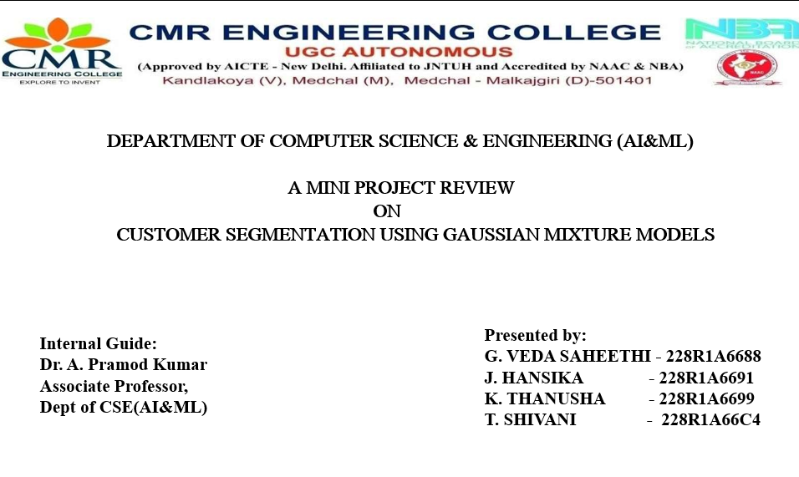
CUSTOMER SEGMENTATION USING GAUSSIAN MIXTURE MODELS
PRESENTED BY-
G.VEDA SAHEETHI – 228R1A6688
J. HANSIKA – 228R1A6691
K.THANUSHA – 228R1A6699
T.SHIVANI – 228R1A66C4

Slide 2
Introduction:
This project involves applying a machine learning technique called Gaussian Mixture Models (GMM) to segment customers based on behavioral data.
The goal is to identify distinct customer profiles to help businesses optimize their marketing strategies and improve customer experiences.
GMM helps identify distinct customer profiles using a probabilistic approach.
Unlike traditional clustering, GMM allows soft clustering, meaning each customer can belong to multiple clusters with certain probabilities.
These segments can be used by businesses to optimize marketing strategies and create more personalized customer experiences.
Overall, the project demonstrates how data-driven segmentation can support smarter business decisions.

Slide 3
Problem Statement:
In today’s highly competitive market, understanding customer behavior is essential for business growth.
Traditional segmentation methods like manual grouping or basic clustering (e.g., K-Means) have limitations:
  They assume clear boundaries between groups.
  They struggle with complex, overlapping data patterns.
These methods may lead to inaccurate segmentation and less effective marketing strategies.
Gaussian Mixture Models (GMM) provide a probabilistic clustering approach:
  Capable of identifying overlapping clusters.
  Suitable for modeling complex, real-world customer data distributions.
There is a need for more flexible and accurate segmentation techniques to improve business decision-making.

Slide 4
Objectives:
To collect and preprocess customer data from a reliable dataset (Marketing Campaign).
To apply Gaussian Mixture Models (GMM) for performing customer segmentation.
To determine the optimal number of clusters using statistical criteria like AIC (Akaike Information Criterion) and BIC (Bayesian Information Criterion) and Silhouette Score.
To visualize the identified customer segments using dimensionality reduction (PCA).
To interpret the characteristics of each segment for actionable business insights.
To help businesses target customers more effectively and enhance marketing strategies.

Slide 5
Proposed System Architecture:
Architecture Design:
Data Collection (Marketing_campaign.csv)
Data Preprocessing
- Drop unneeded cols
- Handle missing data
- Feature scaling
Gaussian Mixture Model
- Fit model
- Predict clusters
Optimal Cluster Selection
- Use AIC/BIC criteria
Business Insights & Recommendations
Result Analysis
- Visualize segments
- Label clusters
Dimensionality Reduction
(PCA for visualization)

Slide 6
Technology Stack Used:
Programming Language:
  Python — Chosen for its simplicity, readability, and powerful ecosystem of machine learning libraries.
Libraries & Frameworks:
1. pandas: For loading the dataset, handling dataframes, and performing data preprocessing.
2. numpy: For numerical operations and array manipulation.
3. matplotlib & seaborn: For creating informative visualizations like cluster plots and AIC/BIC curves.
4. scikit-learn:
  For implementing Gaussian Mixture Models (GMM) for clustering.
  Also used for preprocessing (e.g., StandardScaler) and dimensionality reduction (PCA).
Tools & Environments:
Google Colab: Cloud-based Jupyter environment used for running the project without local setup, with GPU/TPU support if needed.

Slide 7
Implementation Details
3.1 Key Modules and Functionalities:
Data Loading and Preprocessing
Loaded the Mall Customer Segmentation Dataset using pandas.
Handled missing values (if any) to ensure data quality.
Selected key features such as:
  Annual Income (k$)
  Spending Score (1–100)
  (Optional: Age)
Standardized the data using StandardScaler for optimal model p
2. Model Training
Applied Gaussian Mixture Models (GMM) from sklearn.mixture.
Explored multiple values of n_components (i.e., number of clusters).
Used the Expectation-Maximization (EM) algorithm internally to:
Estimate the parameters of Gaussian distributions.
Assign probabilities of data points belonging to each cluster.

Slide 8
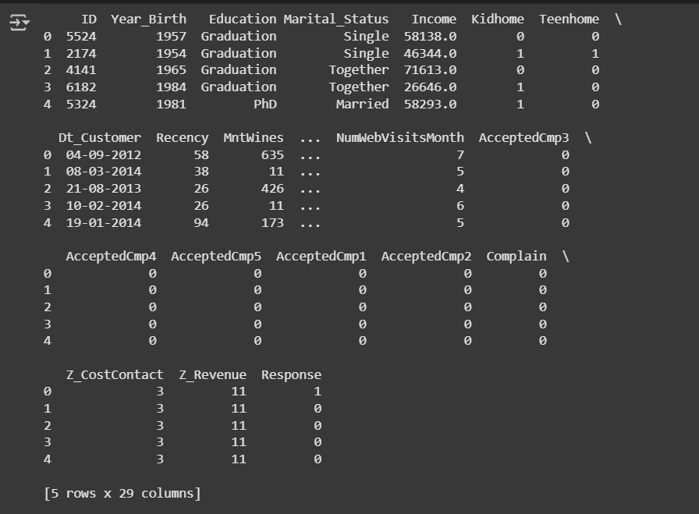
3. Model Selection
Evaluated model performance for various cluster sizes using:
  Akaike Information Criterion (AIC)
  Bayesian Information Criterion (BIC)
Chose the model with the lowest AIC/BIC scores as the optimal clustering solution.
3.2 Screenshots of Developed Components:

Slide 9
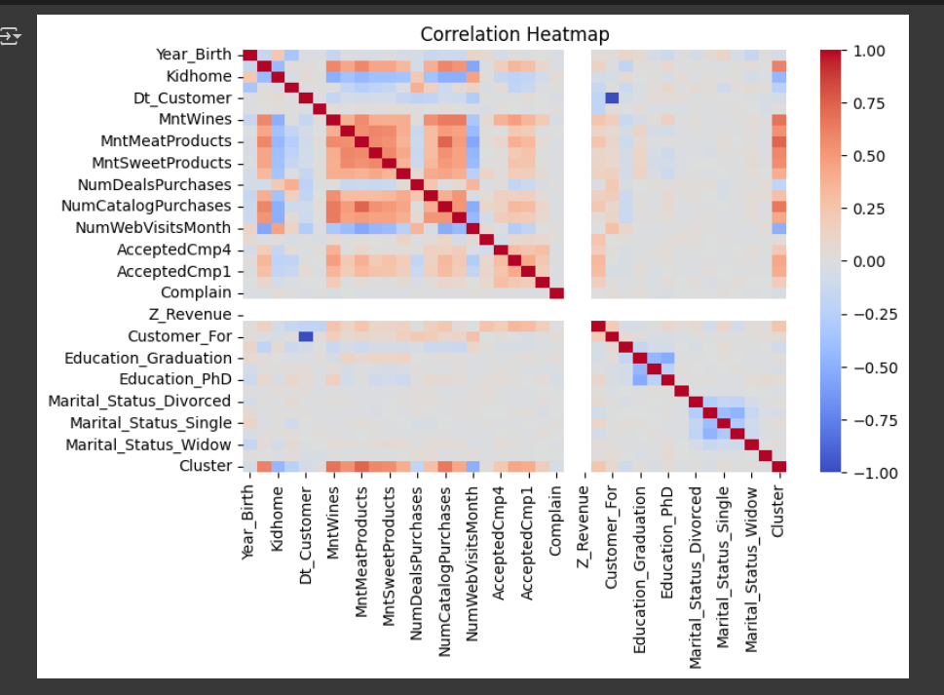
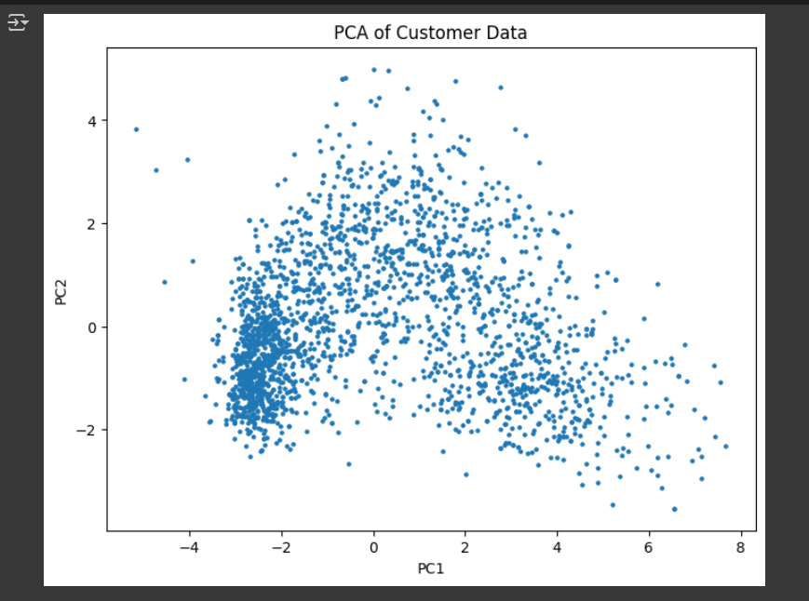
Correlation Heatmap
PCA Space

Slide 10
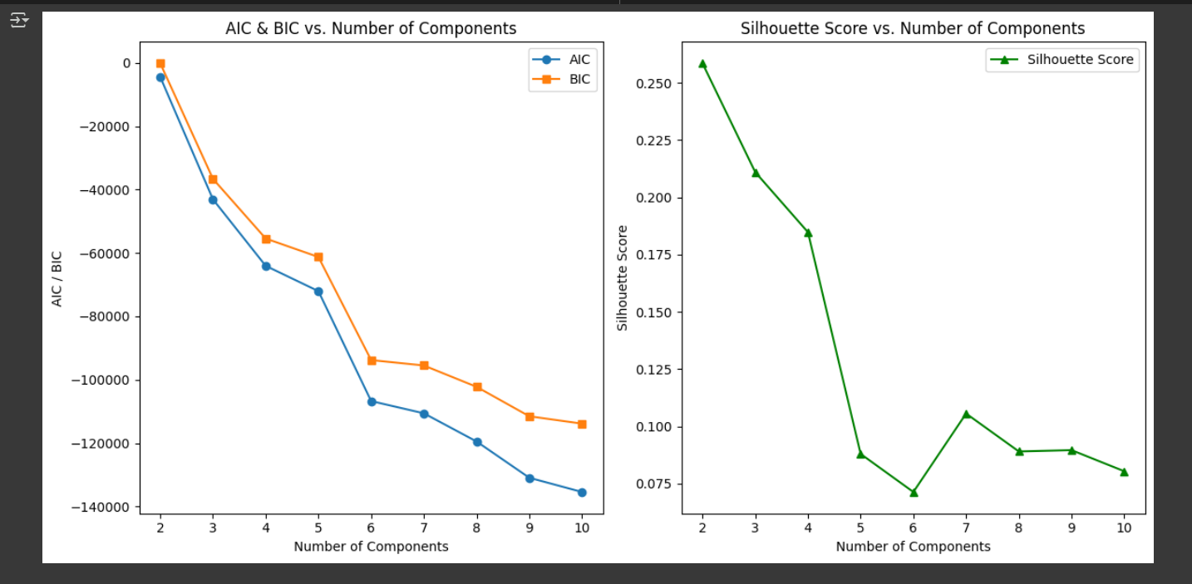
AIC and BIC scores plotted against the number of components to select the best-fitting GMM model.

Slide 11
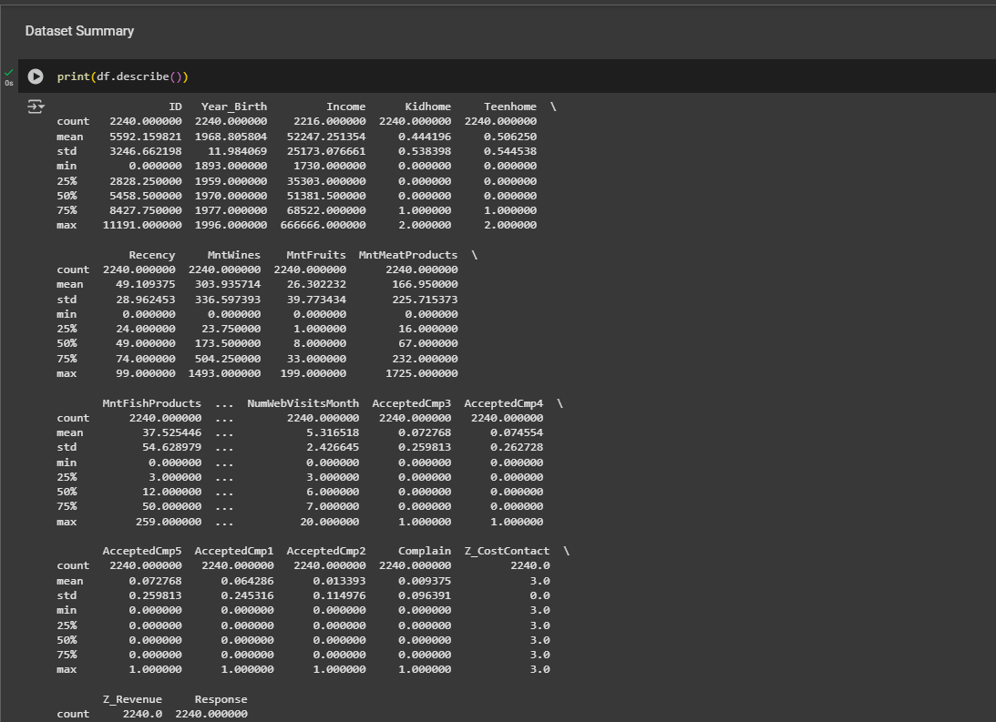
3.3 Code Snippet:

Slide 12
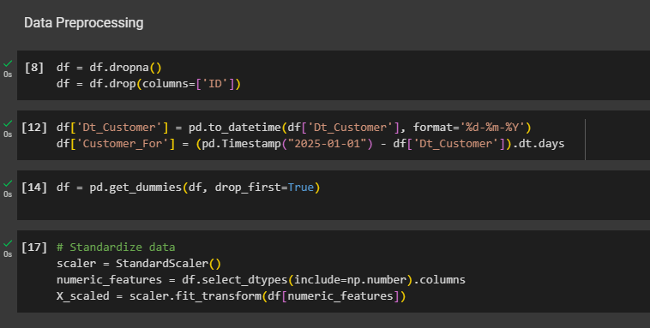
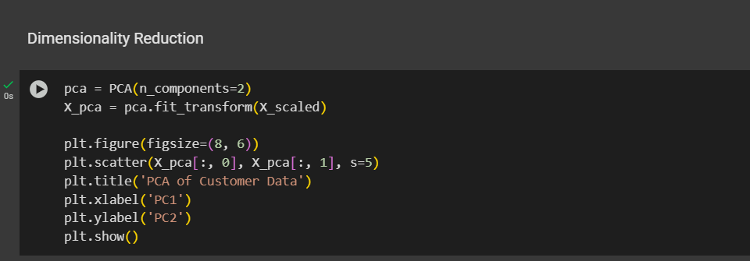

Slide 13
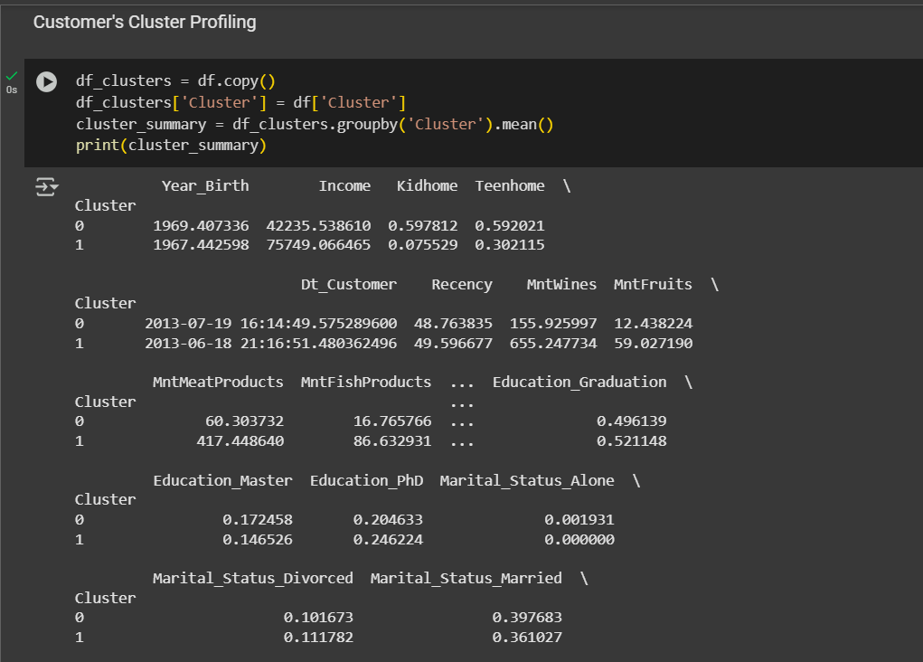
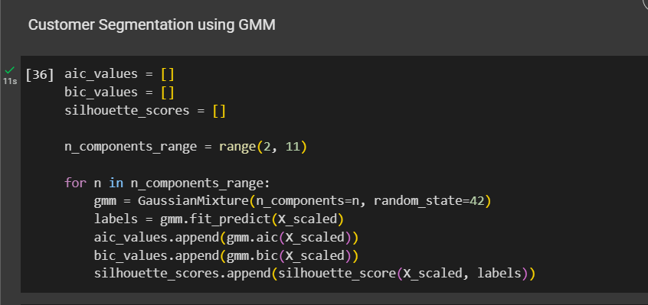

Slide 14
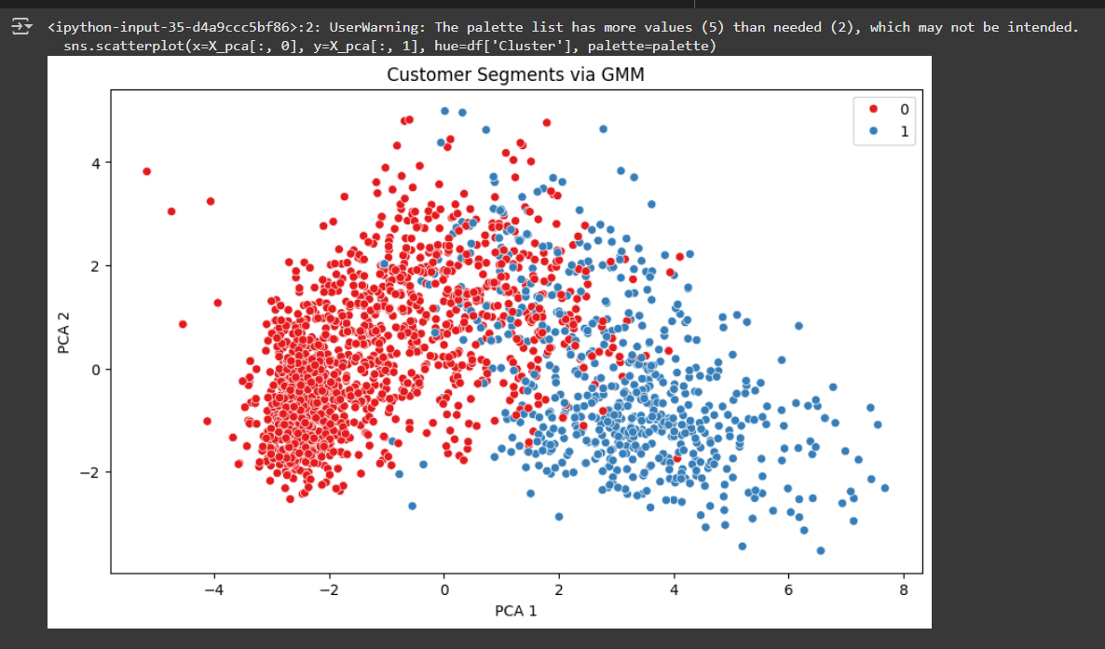
3.4 Results:

Slide 15
4. Execution and Testing:
4.1 Execution Flow:
Import necessary libraries
Load the customer dataset
Clean and preprocess the data
Apply PCA for visualization (optional)
Fit GMM with cluster numbers from 2 to 10
Calculate AIC, BIC, and Silhouette scores
Plot AIC/BIC and Silhouette Score vs. number of clusters
Select the best number of clusters (based on Silhouette or BIC)
Fit final GMM using the best number of clusters
Predict clusters and assign them to each customer
Visualize clusters in PCA 2D space
Profile clusters using group-by and summary statistics

Slide 16
4.2 Testing Strategies:
Unit Testing - Individual components
Test StandardScaler output shape
Test PCA reduces dimensions correctly
Test GMM returns expected number of clusters
2. Integration Testing - Combined modules
Test scaler → PCA → GMM pipeline works end-to-end
Test silhouette score computes correctly after clustering
3. System Testing - full pipeline on dataset
Load and preprocess dataset
Run GMM clustering
Check for successful cluster assignment
Validate plots and cluster profiling summary

Slide 17
S.No | Test Case | Expected Result |  | Result | Remarks (If Fails)
1 | Data Loading | Dataset should load successfully into a DataFrame |  | Pass | File path or format may be incorrect
2 | Data Preprocessing | Dataset should be cleaned and scaled |  | Pass | Missing values or encoding errors
3 | PCA Transformation | Data should reduce to 2D components |  | Pass | PCA might fail if input shape is incorrect
4 | GMM Model Fitting | GMM should fit data and assign clusters |  | Pass | Improper number of components or convergence error
5 | AIC/BIC/Silhouette Evaluation | Metrics should be calculated for 2–10 components |  | Pass | Empty clusters or model not converging
6 | Cluster Visualization | PCA scatterplot should show clustered customers |  | Pass | Plotting fails if cluster labels are missing
7 | Optimal Cluster Detection | Best cluster count should be selected based on metrics |  | Pass | Metrics not improving may indicate bad input features
8 | Cluster Assignment | Each customer should be assigned a cluster label |  | Pass | Missing values or label mismatch
9 | Cluster Profiling | Summary statistics per cluster should be generated |  | Pass | DataFrame grouping might fail if cluster column missing

Slide 18
5. Challenges & Solutions
Issues Faced During Development
Difficulty in choosing the number of clusters.
Overlapping clusters due to probabilistic nature of GMM.
Preprocessing affected results significantly.
Slow model convergence with high n_components.
How They Were Resolved
Used AIC and BIC values to objectively decide optimal clusters.
Scaled features using StandardScaler to normalize distributions.
Visualized clusters in 2D and 3D to understand overlap.
Reduced features using PCA (Principal Component Analysis) for faster computation.

Slide 19
6. Conclusion & Future Scope:
Conclusion:
Successfully segmented customers using Gaussian Mixture Models.
Model selected based on statistical evaluation (AIC/BIC).
Gained insights into customer types such as high spenders, budget shoppers, etc.
Demonstrated flexibility and effectiveness of GMM over traditional clustering methods.
Future Enhancement:
Apply GMM to larger and more diverse customer datasets.
Use advanced dimensionality reduction techniques like t-SNE or UMAP.
Integrate segmentation with recommendation systems.
Real-time clustering in web apps for dynamic user profiling.
Extend the model to consider temporal features for time-based segmentation.

Slide 20
References:
[1] "Customer Segmentation Using Machine Learning" by Suresh Kumar Gorakala and Avinash P. (2018). Explores practical implementations of clustering for segmenting retail customer data.
[2] "A Tutorial on Clustering Algorithms" by Aggarwal and Reddy (2014). Offers an in-depth comparison of clustering techniques, including KMeans and Gaussian Mixture Models, for unsupervised learning tasks.
[3] "Pattern Recognition and Machine Learning" by Christopher M. Bishop (2006). A foundational text that explains the mathematics behind GMM and EM algorithm in detail.
[4] "Customer Segmentation Based on Spending Habits Using GMM" by Ali et al. (2020). Applies Gaussian Mixture Models to e-commerce customer data to identify high-value user segments.
[5] "Scikit-learn: Machine Learning in Python" by Pedregosa et al. (2011). Introduces the scikit-learn library, used widely for implementing clustering, dimensionality reduction, and evaluation metrics.
[6] "A Comparative Study of Clustering Techniques for Customer Segmentation" by Jain and Dubes (2015). Compares the performance of different clustering methods including GMM, DBSCAN, and KMeans on retail datasets.

